Slide 1
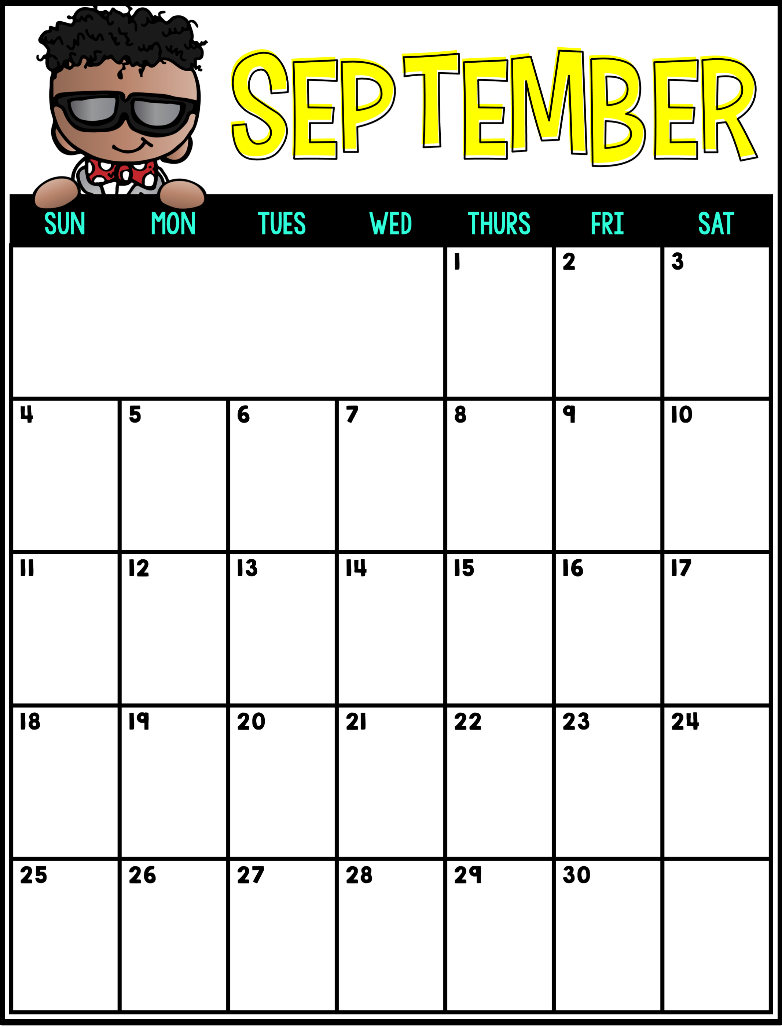
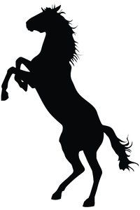
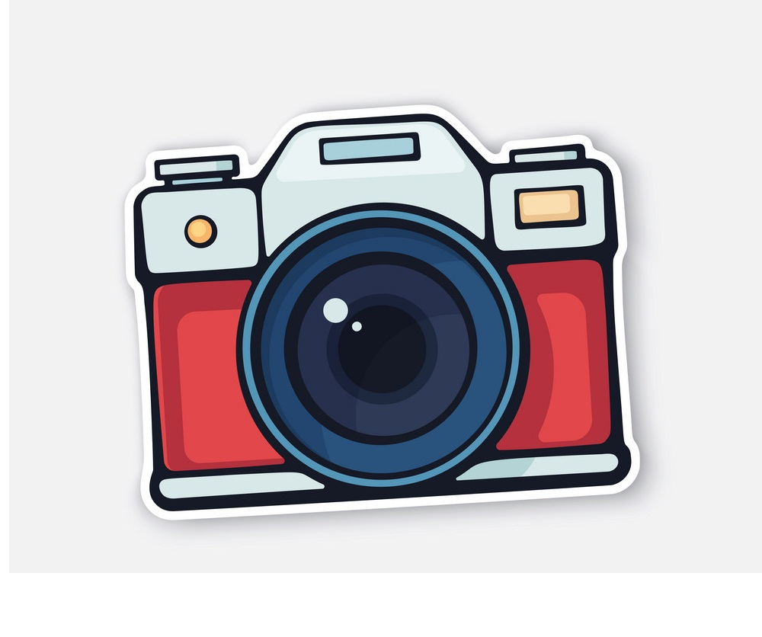
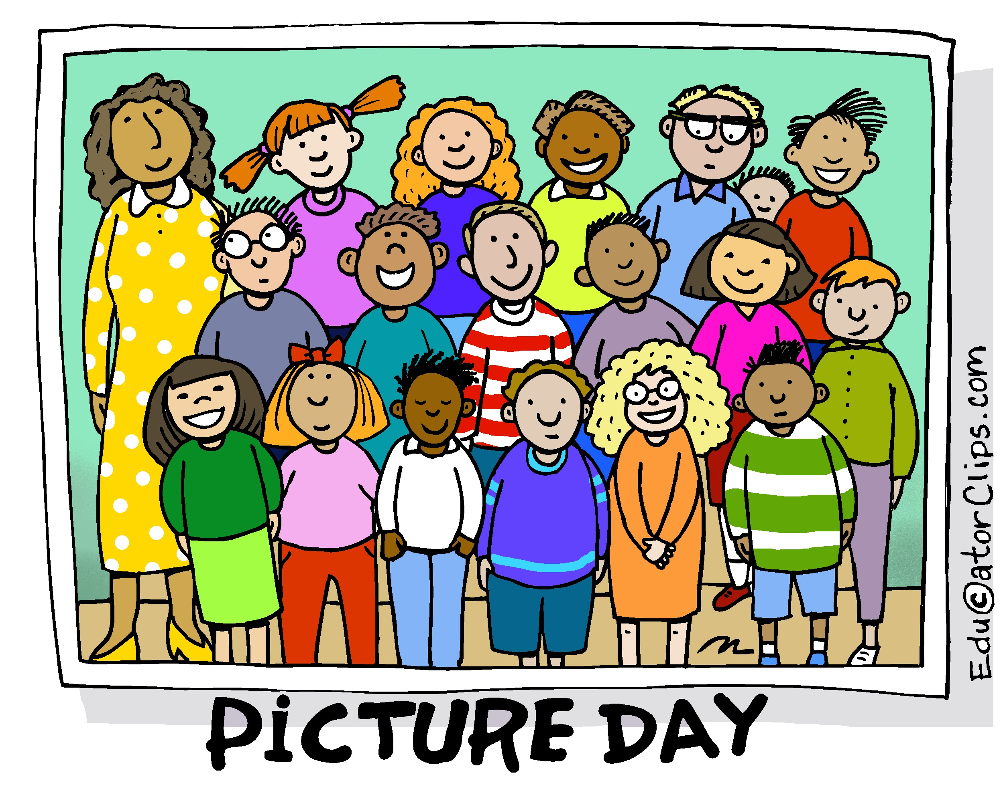
First Day of School,
Last Names A-J
First Day of School, Last Names K-S
Barrie Spirit Day
Happy Birthday,
Tenley!
Barrie Spirit Day
Picture Day
Happy Birthday,
Mason!
Barrie Spirit Day
Barrie Spirit Day

