Slide 1
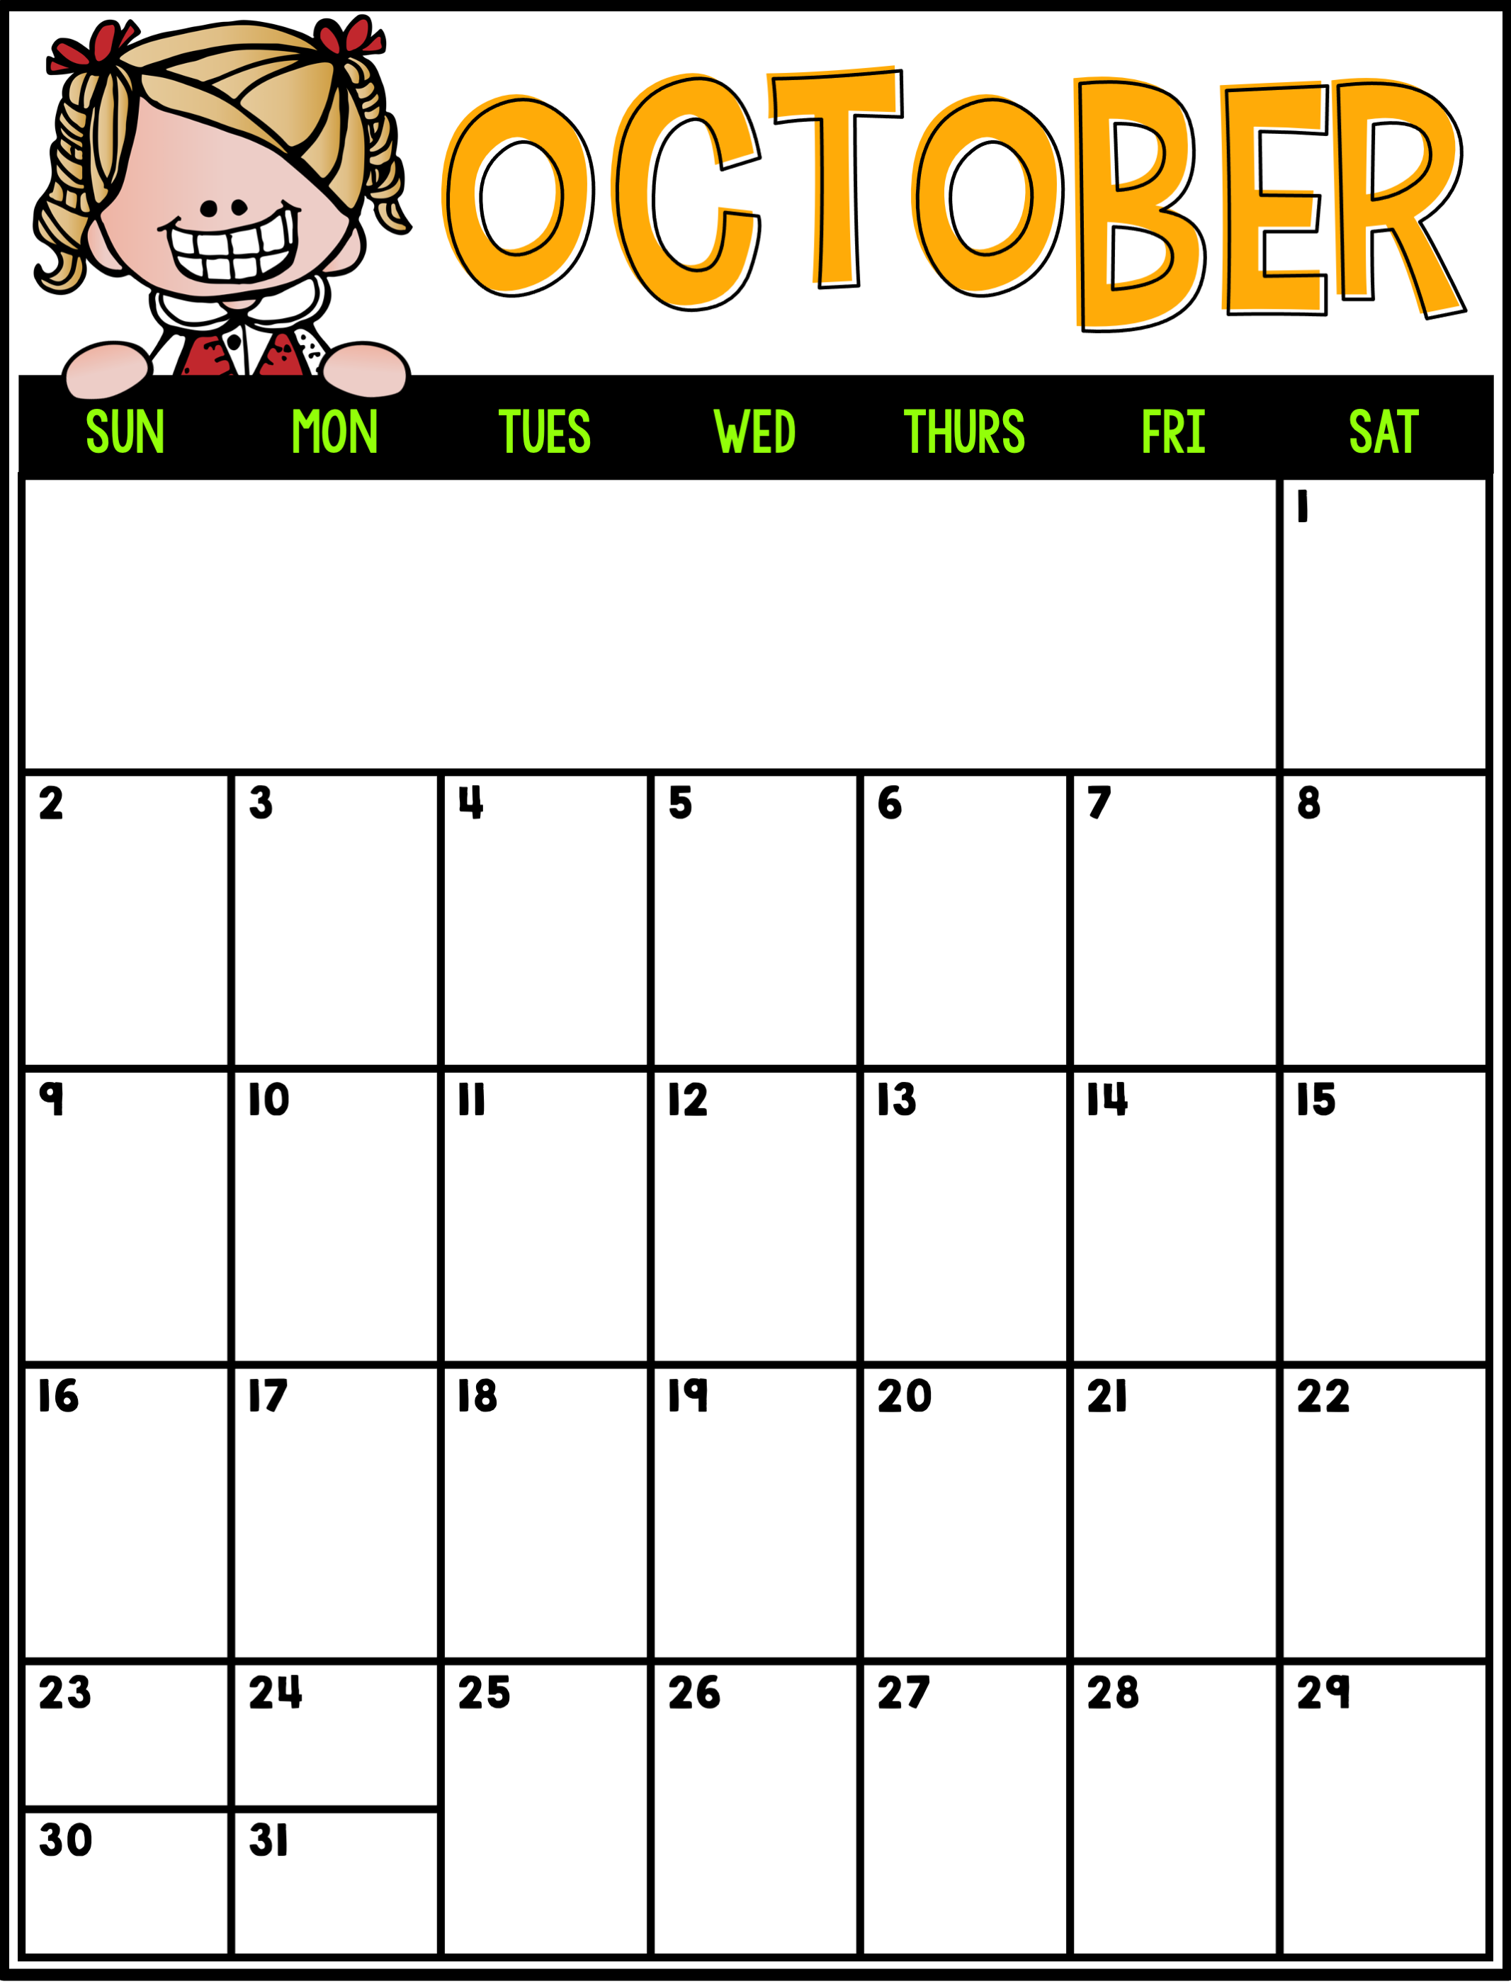
Upcoming events in October (dates TBD):
PALS Testing (Window Opens Wednesday 10/12 to Wednesday 10/26)
Apples & Applesauce
Fall party
**look for notes coming home
Barrie Spirit Day
Walking Field Trip Fire Station
Barrie Spirit Day
PALS Window Opens
Fall Family Fun Night
Picture Retake Day
Field Trip- Pumpkin Farm
Happy Birthday, Maxwell!

