Slide 1
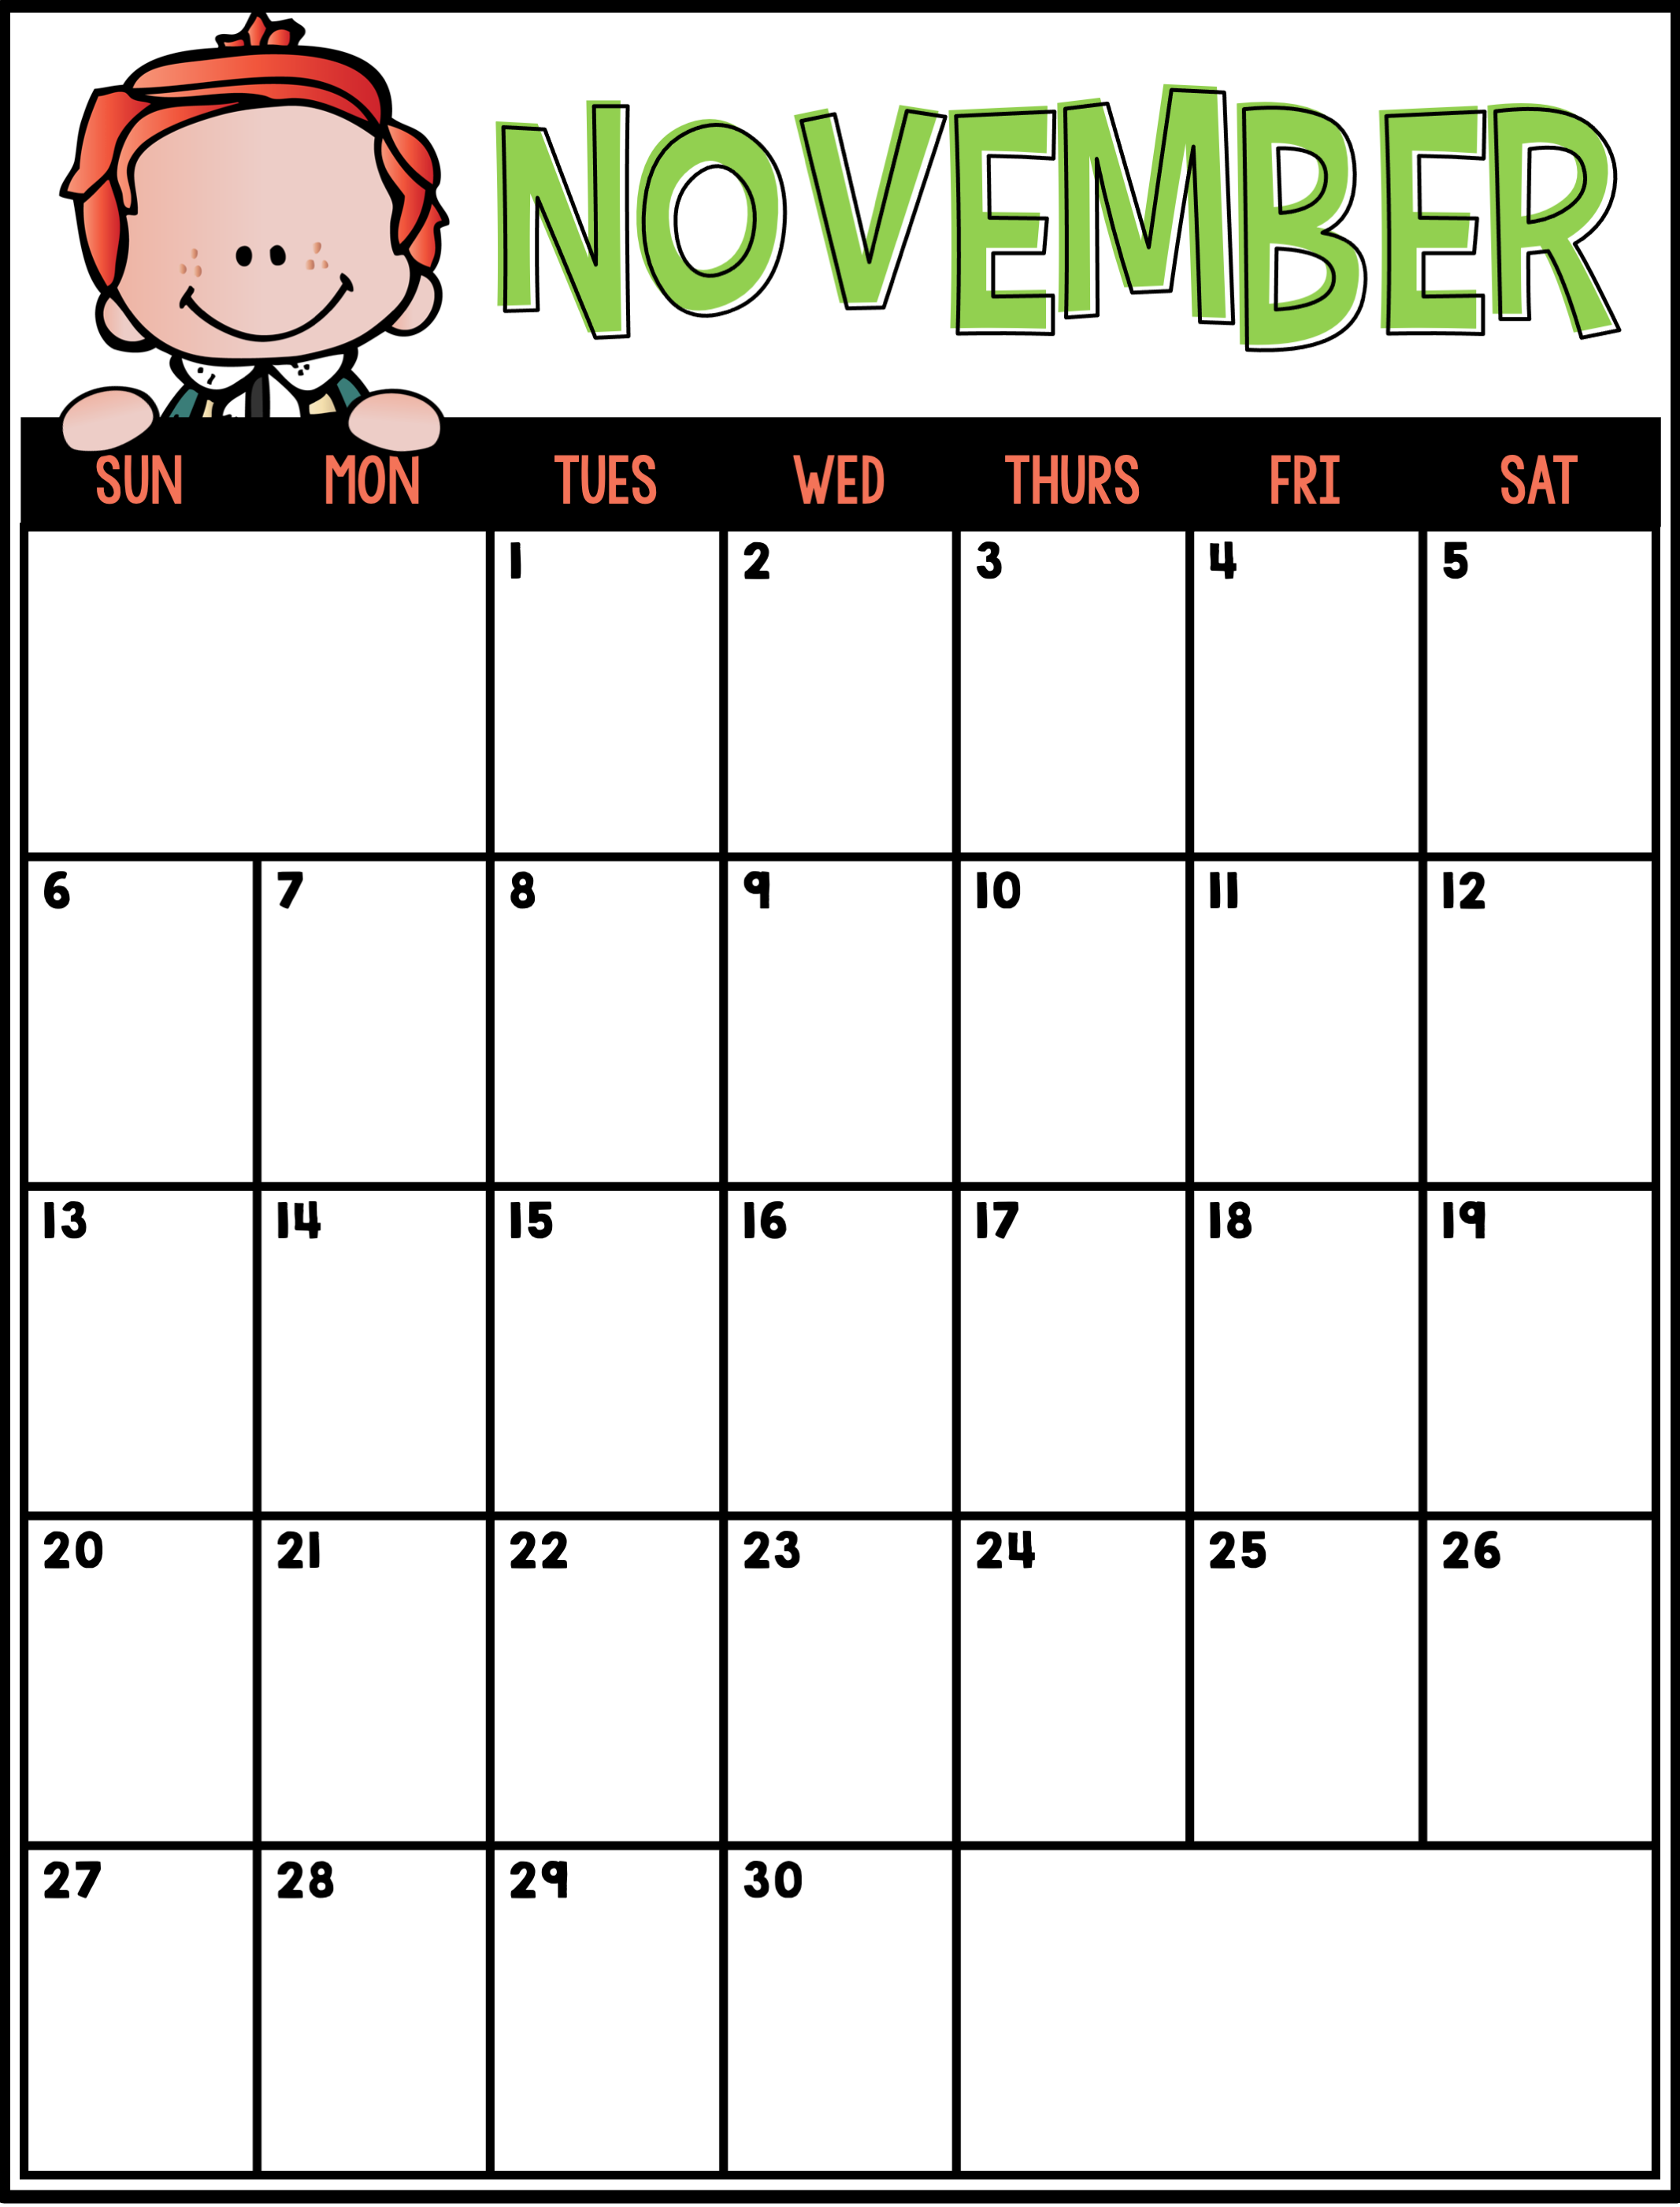
Barrie Spirit Day
Happy Birthday, Joshua
Barrie Spirit Day
Star of the Week- Westyn
Barrie Spirit Day
Star of the Week- Melanie
Parent-Teacher Conference
Parent-Teacher Conference
Harvest Party

