Slide 1
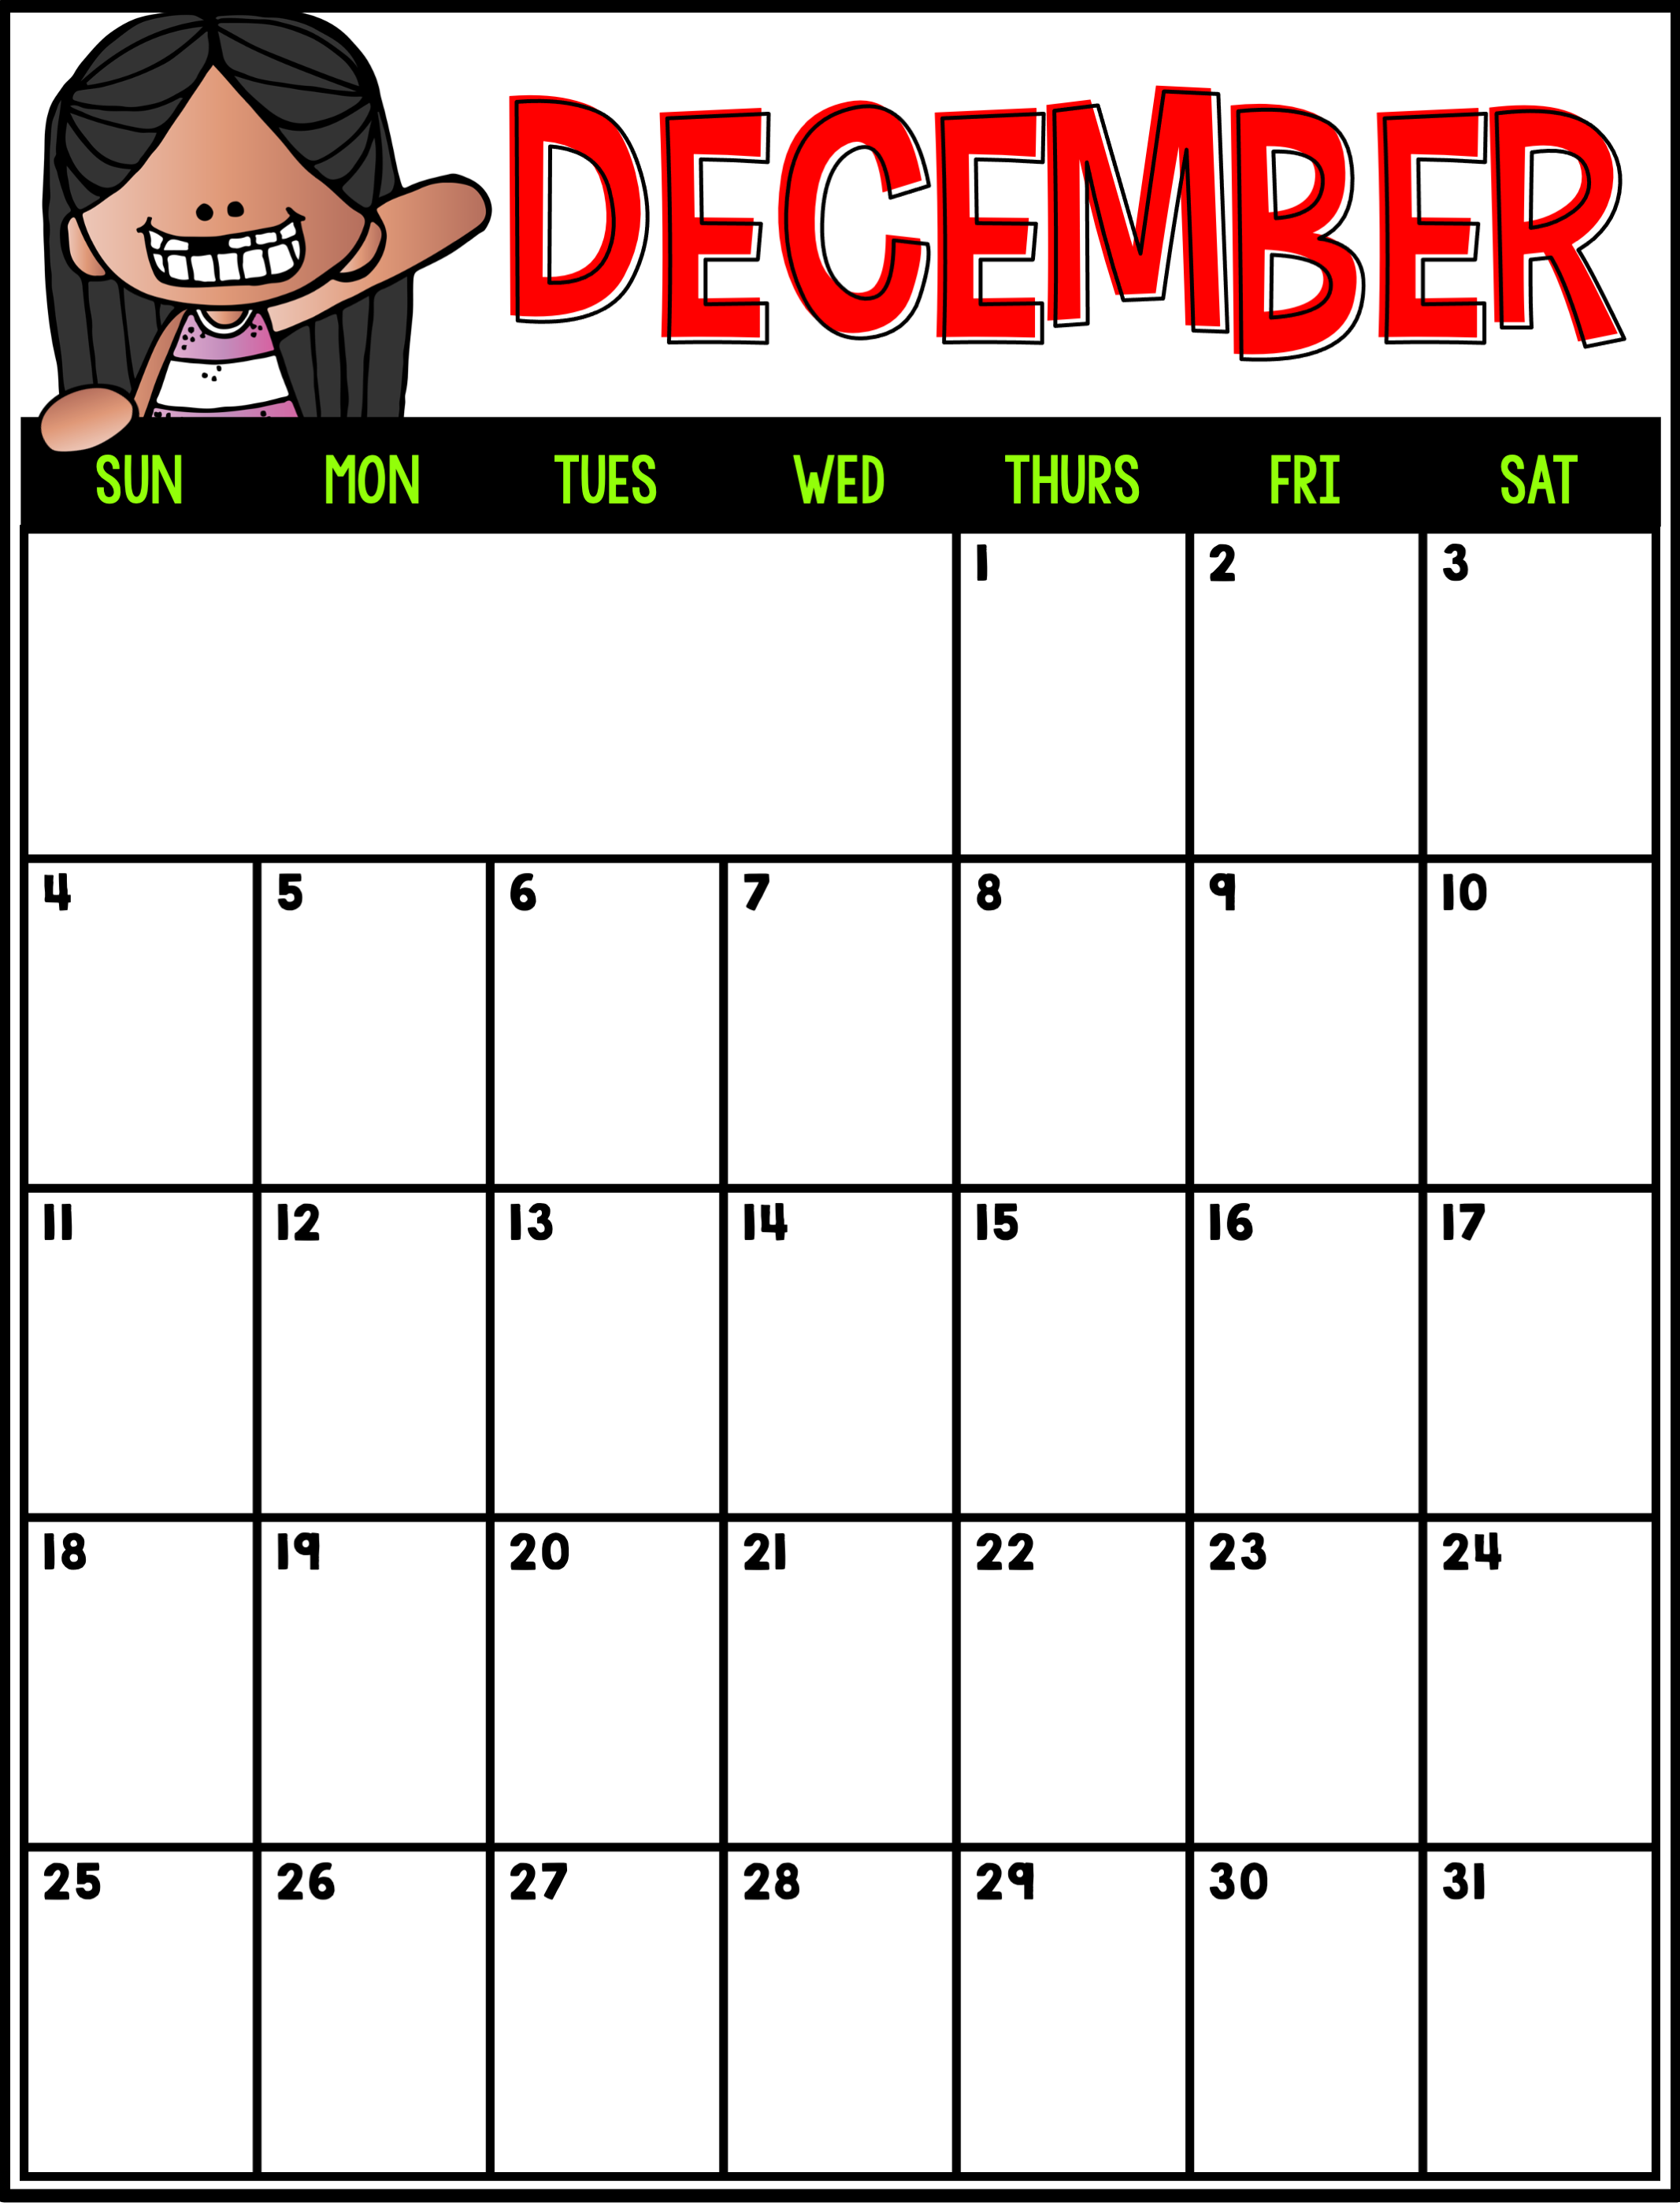
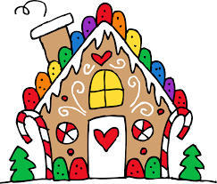
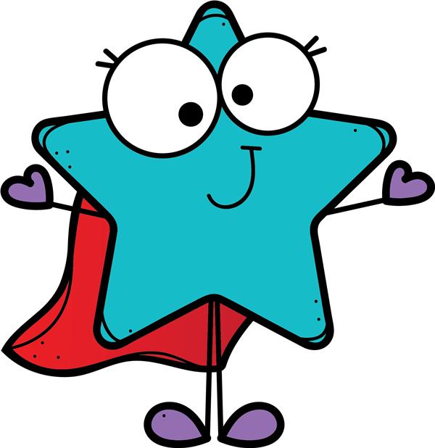
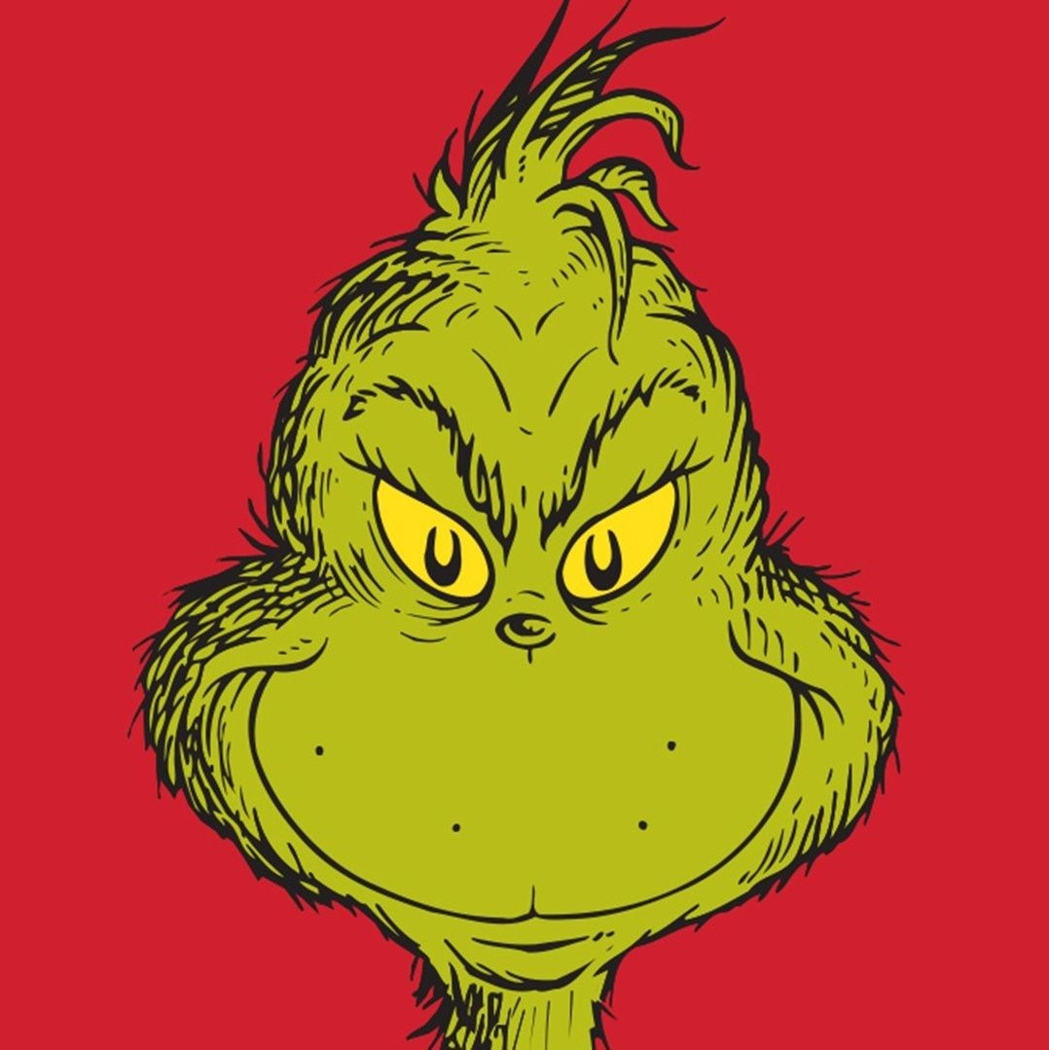
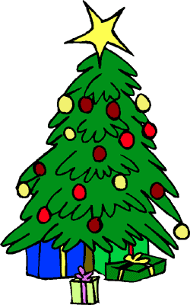
Barrie Spirit Day
Gingerbread Houses
Winter Concert
Barrie Spirit Day
Star of the Week- Mason
Grinch Day
Star of the Week- Max
Happy Birthday, Dariel
Holiday Party
Student Council Dress-Up Day: Mis-Match Day (Crazy Pattern Day)

